Slide 1

Comparison of Strong and Weak Entities in ER Modeling with Real-World Examples
CSA0503 - Database Management Systems
PRESENTED BY:
SIDDHI SRIVASTAVA. P(192521454)
UNDER THE GUIDANCE:
DR. J. Ruby Elizabeth

Slide 2


ABSTRACT
ER modeling is a conceptual database design technique used to represent entities and their relationships.
Strong entities have their own primary key and can exist independently.
Weak entities depend on strong entities for identification and use a partial key.
Understanding the difference between strong and weak entities helps in designing efficient and normalized databases.
Real-world examples such as banking, e-commerce, hospitals, and libraries demonstrate the practical use of these entities.
This presentation compares strong and weak entities, their ER diagram representations, characteristics, and importance in database design.

Slide 3
INTRODUCTION
Entity-Relationship (ER) Modeling is a conceptual design technique used to represent data and the relationships between entities.
An entity is a real-world object, such as a student, employee, customer, or product, about which data is stored.
Entities are classified into Strong Entities and Weak Entities based on their ability to exist independently.
Strong entities have their own primary key, while weak entities depend on strong entities for identification.
Understanding these concepts helps in creating accurate, consistent, and efficient database designs with proper relationships and data integrity.

Slide 4
PROBLEM STATEMENT
Incorrect identification of strong and weak entities can lead to poor database design.
Treating weak entities as independent entities may result in data redundancy and inconsistency.
Weak entities require a strong entity and a partial key for proper identification and cannot exist independently.
Improper modeling of entity relationships can affect referential integrity and database reliability.
Real-world applications such as banking, hospitals, e-commerce, and libraries require accurate representation of strong and weak entities.

Slide 5
OBJECTIVES
To understand the concept of Strong Entities and Weak Entities in ER modeling.
To identify the key differences between strong and weak entities based on their characteristics and identification methods.
To explain the ER diagram representations of strong and weak entities using appropriate symbols.
To demonstrate the role of primary keys, partial keys, and identifying relationships in database design.
To analyze real-world examples where strong and weak entities are used in various applications such as banking, healthcare, e-commerce, and education.

Slide 6
INTRODUCTION TO ER MODELLING
What is ER Modeling?
Entity-Relationship (ER) Modeling is a conceptual database design technique introduced by Peter Chen in 1976. It provides a graphical representation of data, entities, attributes, and relationships before the database is implemented.
Purpose of ER Modeling
Represents real-world objects in a database.
Helps understand relationships among data.
Reduces redundancy and improves consistency.
Serves as a blueprint for database design.

Slide 7
WHAT IS AN ENTITY?
An Entity is a real-world object, person, place, event, or concept about which information is stored in a database.
Characteristics
Has attributes describing it.
Represents an object in the real world.
Can participate in relationships.
Types of Entities
Strong Entity
Weak Entity

Slide 8
STRONG ENTITY
A Strong Entity is an entity that can be uniquely identified by its own attributes. It possesses a Primary Key and exists independently.
Features:
Independent existence
Own Primary Key
Easily identifiable
Can exist without any other entity
ER Representation:
Single Rectangle
Primary Key is underlined

Slide 9
WEAK ENTITY
A Weak Entity cannot be uniquely identified by its own attributes. It depends on a Strong Entity and contains a Partial Key.
Features
Dependent entity
No Primary Key of its own
Identified using owner entity
Cannot exist independently
ER Representation
Double Rectangle
Double Diamond (Identifying Relationship)

Slide 10
STRONG ENTITY VS WEAK ENTITY
Feature | Strong Entity | Weak Entity
Identification | Own Primary Key | Partial Key + Owner Key
Existence | Independent | Dependent
Representation | Single Rectangle | Double Rectangle
Participation | Partial/Total | Total Participation
Relationship | Normal | Identifying
Primary Key | Available | Not Available
Dependency | None | Depends on Strong Entity

Slide 11
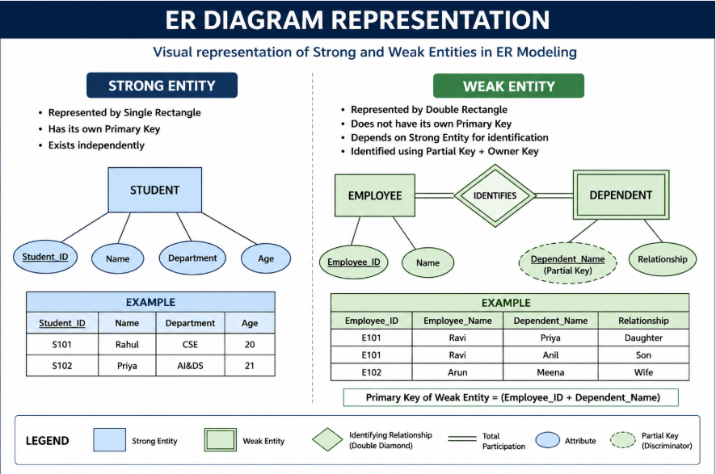
Diagram Representation

Slide 12
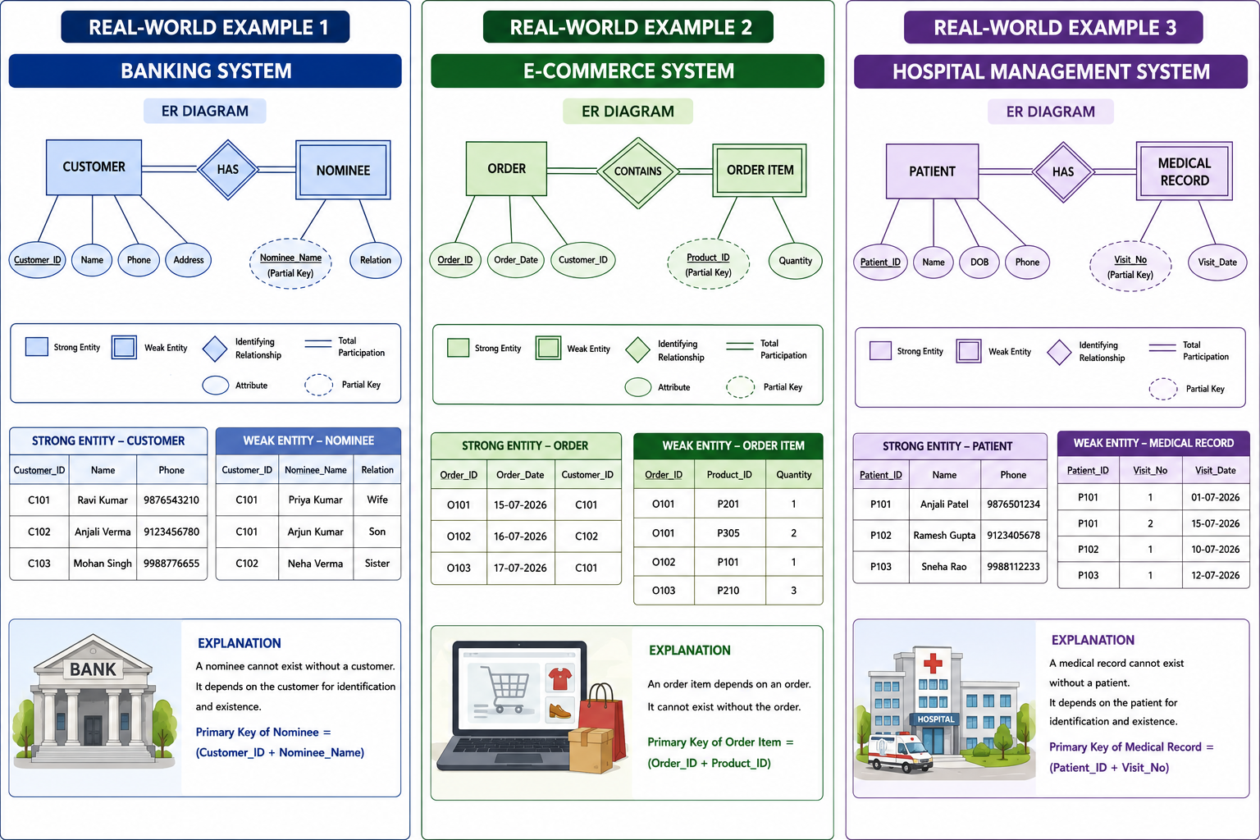
Real world applications

Slide 13
Advantages and limitations
Strong Entity Advantages
Easy identification
Independent existence
Faster searching
Simpler implementation
Limitations
Cannot model dependent objects
Requires separate entities for related details
Weak Entity Advantages
Represents dependent data accurately
Maintains referential integrity
Reduces redundancy
Limitations
Cannot exist independently
Requires identifying relationship
More complex implementation

Slide 14
FUTURE SCOPE
• Apply strong and weak entity concepts in designing large-scale database systems for enterprises and cloud applications.
Integrate ER modeling with advanced database technologies such as NoSQL and distributed databases.
Use ER modeling techniques in AI, IoT, healthcare, banking, and e-commerce applications for efficient data management.
Develop automated ER diagram generation and validation tools to simplify database design.
Enhance database performance and scalability by adopting improved modeling techniques and best design practices.

Slide 15
CONCLUSION
• Strong entities can exist independently and have their own primary key, whereas weak entities depend on strong entities for identification.
Understanding the differences between these entities is essential for creating accurate ER diagrams and database structures.
Proper use of strong and weak entities helps maintain referential integrity, reduces redundancy, and improves data consistency.
Real-world applications such as banking, hospitals, libraries, and e-commerce effectively utilize these concepts in database design.

Slide 16
THANK YOU !!!

